Slide 1
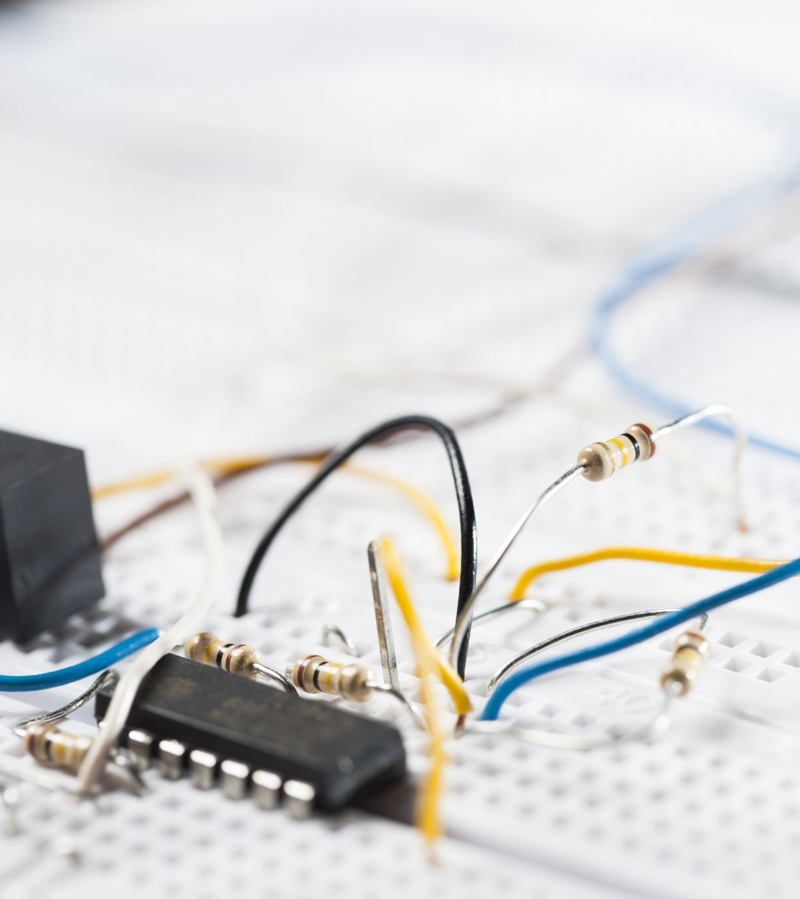
Analog IC Design
A Low-Power Low-Noise CMOS Amplifier for Neural Recording Applications
Instructor: Prof. Abhishek Srivastava Rohan Gupta – 2020112022

Slide 2
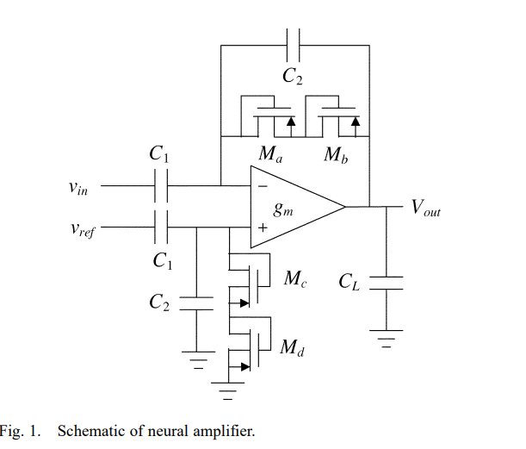
Introduction
The goal is to design a low-noise low-power bio signal amplifiers capable of amplifying signals in the millihertz-to-kilohertz range.
Fig. 1 shows the schematic of our bioamplifier design. Given in the paper.
Fig 1: Schematic of Neural Amplifier

Slide 3
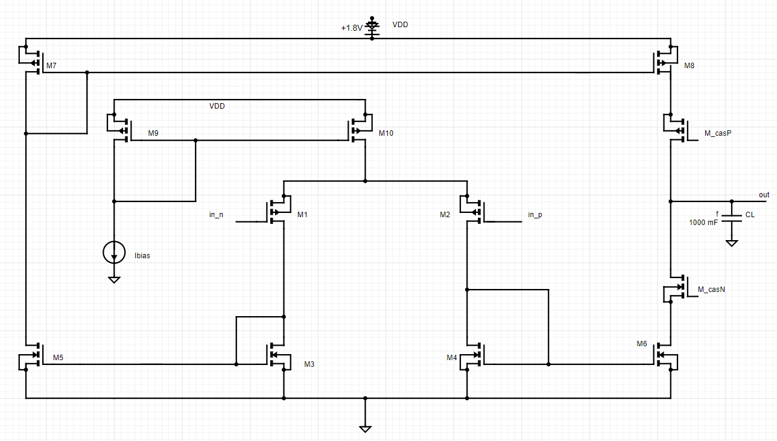
Fig 2: current-mirror OTA used in the bioamplifier.

Slide 4
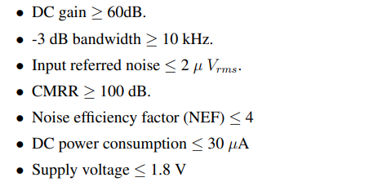
Output transconductance Amplifier
Fig. 4 shows a schematic of the current-mirror OTA used in the bioamplifier. The circuit topology is a standard design suitable for driving capacitive loads, the sizing of the transistors is critical for achieving low noise at low current levels.
The bias current is set to 8 uA, giving devices – drain currents of 4 uA. At this current level, each transistor may operate in weak, moderate, or strong inversion depending on its ratio.
Given Design Specification for the OTA:

Slide 5



Devices | ID(uA) | Inversion Coeffecient | Region of Operation
M1,M2 | 4 | <1 | Subthreshold(For greater gm1)
M3,M4,M5,M6 | 4 | >10 | Strong Inversion
M7,M8 | 4 | >10 | Strong Inversion
M9,M10 | 8 | >10 | Strong Inversion,Saturation
M_cascN | 4 | 1<IC<10 | Moderate Inversion
M_cascP | 4 | >10 | Saturarion
DC gain = (${gm}_{1}$*gm*$r_{o}^{2}$)/2, ${gm}_{1}$ =Transconductance of M1, gm=Transconductance of Cascode Mosfets
From Design Specifications,
Imax = 30uA => Ibias<=10uA => Chosen Ibias = 8uA
For M1 ,M2 IC<1,
$IC= \frac{Id}{Is}→ \frac{Id}{} <1$ From the following we get $(\frac{W}{L})_{1,2}>444.44$
2. Similarly for $M_{3−6}<4.222 M_{7−8} <3.4$
4. -3dB Bandwidth ≥ 10 KHZ (Dominant pole exists at -3db frequency)
$\frac{1}{Rout∗C_{L}}$ ≥ 10 KHZ
Assumed $C_{L}=10f farad,⇒As,Rout$=(gm* $r_{o}^{2}$)/2 and $r_{o}$ =${10}^{7}$ ohm
we get, gm $≤$ 200 $μ S$
From gm, we get ${(\frac{W}{L})}_{CasN}$≤ 22.5 and ${(\frac{W}{L})}_{CasP}$ ≤ 45.

Slide 6
Design Parameters from Hand calculation
Devices | Type | W/L
M1,M2 | p18.7 | 80/0.18
M3,M4,M5,M6 | n18.9 | 10/5
M7,M8 | p18.9 | 5/10
M9,M10 | p18.6 | 1.2/1.2
M_cascN | n18.9 | 12/3.2
M_cascP | p18.8 | 6.4/3.2
Specification Achieved After Hand calculations:
Specifications | Value
Gain | 35.726628dB
Unity Gain Badwidth | 5.2966344MHz
Phase Margin | 55°
Gain Margin | 19.871138dB

Slide 7
Final Circuit with chosen MOSFET and sizing
Devices | Type | W/L | Hand Calculated
M1,M2 | p18.7 | 80/0.18 | 80/0.18
M3,M4,M5,M6 | n18.9 | 27/3 | 10/5
M7,M8 | p18.9 | 2/9 | 5/10
M9,M10 | p18.6 | 1.2/1.2 | 1.2/1.2
M_cascN | n18.9 | 40/5 | 12/3.2
M_cascP | p18.8 | 90/1 | 6.4/3.2
CL | 0.5pF | 1f
Specification Achieved After Final design:
Specifications | Value
Gain | 62.117163dB
Unity Gain Badwidth | 5.4450265MHz
Slew Rate | 5.1 MV/s
Phase Margin | 42.80548°
Gain Margin | 5.588399dB

Slide 8
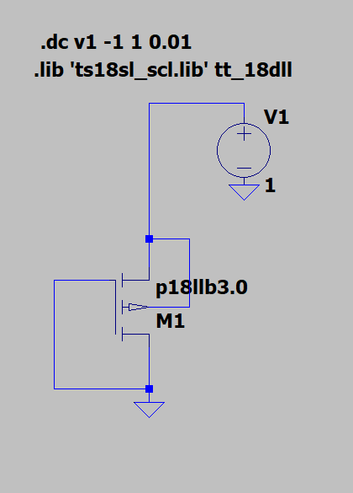
Pseudo PMOS Resistor
The pseudo resistor is capable of resisting large DC offsets and provide stability when used in feedback
The maximum resistance is around 229.99117GOhm
The maximum incremental resistance is approximately 275.0 GΩ
Fig 3: Pseudo PMOS Schematic

Slide 9
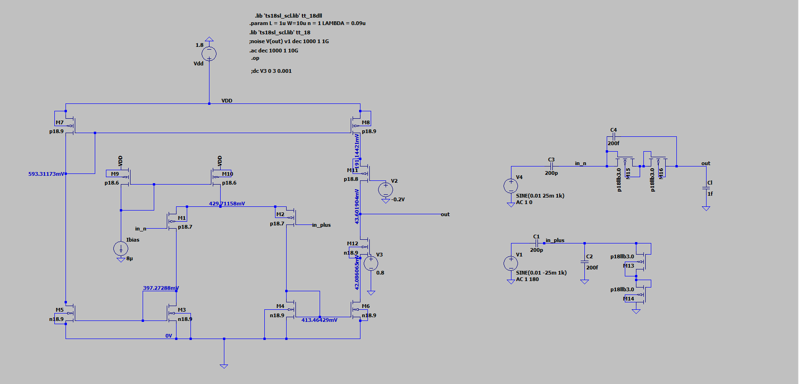
Fig 4 : Neural Amplifier Schematic

Slide 10
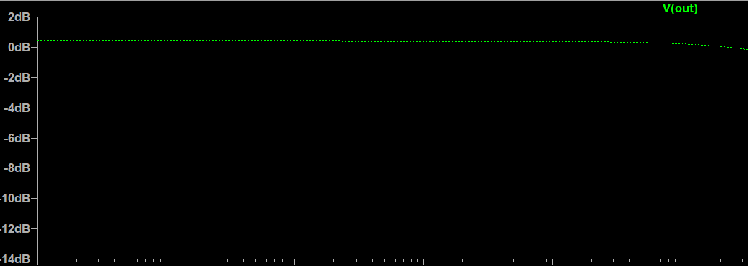
Neural Amplifier
Specifications | Value
Gain | 1.3262585dB
Unity Gain Badwidth | 2.837919MHz
As in above Fig 4: using Pseudo resistor and the OTA a neural amplifier is designed.
Pseudo Resistors is connected in such way that it acts as diode connected.
The use of this to decrease the distortions for large output signals. And to get fast settling time for change in inputs

Slide 11
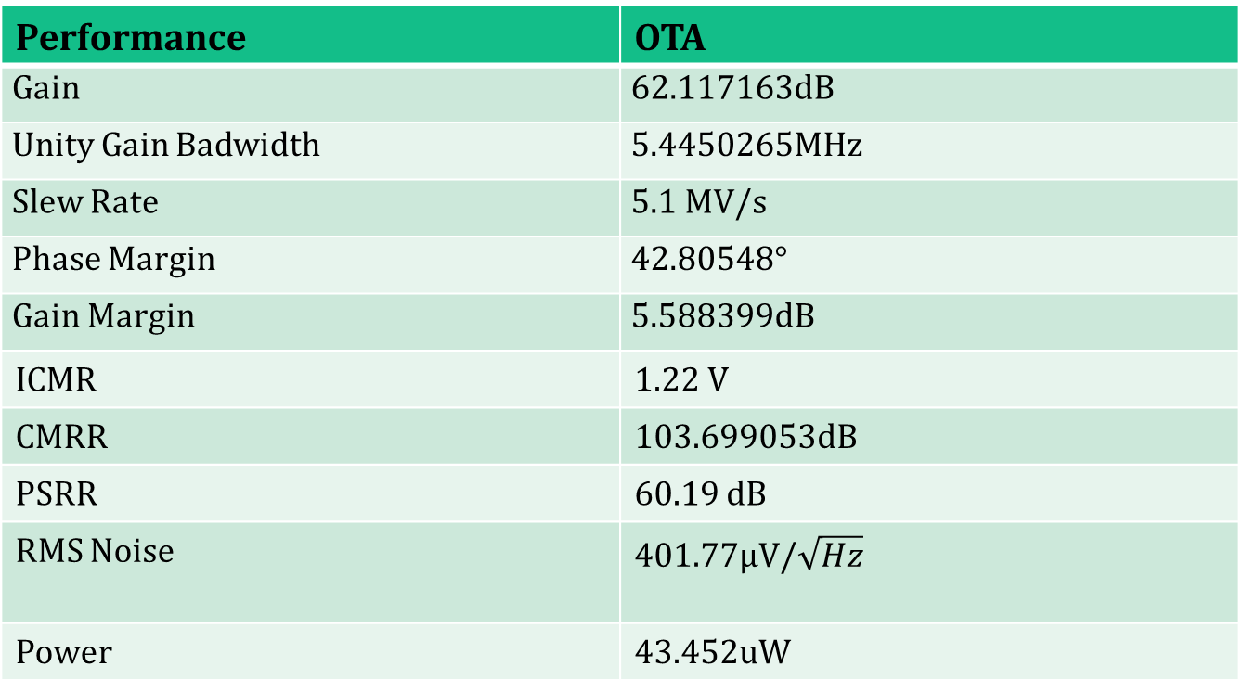
Final Design and Results:
Performance | OTA
Gain | 62.117163dB
Unity Gain Badwidth | 5.4450265MHz
Slew Rate | 5.1 MV/s
Phase Margin | 42.80548°
Gain Margin | 5.588399dB
ICMR | 1.22 V
CMRR | 103.699053dB
PSRR | 60.19 dB
RMS Noise | 401.77µV/$\sqrt{Hz}$
Power | 43.452uW

Slide 12
References
R. R. Harrison and C. Charles, A low-power low-noise CMOS amplifier for neural recording applications, IEEE J. Solid-State Circuits, vol. 38, no. 6, pp. 958965, Jun. 2003.

